Slide 1
A New Way to Develop
Spec Driven Development Is Here
GitHub SpecKit · Itential Skills · Claude Code

Slide 2
What We’ll Cover
PART 1
The Paradigm Shift
Why specs are the new source of truth
PART 4
Hands-On Guide
Try it yourself — step-by-step exercise
PART 2
GitHub SpecKit
8 steps from install to implementation
PART 5
Itential + SDD
Builder Skills on the Anthropic Marketplace
PART 3
Live Example
Cisco pyATS interface health check
PART 6
Q&A
Questions and discussion

Slide 3
PART 1
The Paradigm Shift
Why specs are the new source of truth

Slide 4
The Old Way: Code Is King
For decades, specifications served code — they were scaffolding we built and discarded once the "real work" of coding began.
PRDs written, then ignored
Specs rarely kept pace with code
The ambiguity tax
Vague requirements → rework cycles
Gap between intent & code
Documentation and implementation drift apart

Slide 5
The Power Inversion
Spec Driven Development
Before SDD
With SDD
Code is the source of truth
Specs serve code
Documentation drifts
Intent gets lost in implementation
Spec is the source of truth
Code serves specifications
Spec and code stay in sync
AI generates from clear intent
Specifications don't serve code — code serves specifications.

Slide 6
You Have Been Doing This for Years
Network engineers are the most naturally prepared SDD practitioners.
01
Gather Requirements
02
Document Current State
That's not called SDD in our world. We call it "doing your job."
03
Define Post-Change Behavior
04
Get Stakeholder Sign-Off
05
Write Test & Rollback Plans
06
Then Make the Change

Slide 7
PART 2
GitHub SpecKit
The 8-Step SDD Workflow
92K+ GitHub Stars · Open Source · Agent Agnostic

Slide 8
01
Install SpecKit
uvx --from git+https://github.com/github/spec-kit.git specify init <PROJECT>
Install the specify CLI with uv or pipx
Works with Claude Code, Copilot, Gemini, Windsurf, and more
Python 3.11+ required — uv is the recommended package manager
One command to bootstrap your entire SDD environment

Slide 9
02
Initialize Working Directory
specify init . --integration claude
Creates .specify/ directory with templates, scripts, and memory
Sets up agent-specific prompts and slash commands
Automatically configures Git branch management
Choose your AI integration: Claude, Copilot, Gemini, etc.

Slide 10
03
Constitution
/speckit.constitution
Define immutable project principles and guardrails
Coding standards, security rules, testing requirements
What the system must always do and must never do
Persists across all features — your project's DNA

Slide 11
04
Specification
/speckit.specify
Describe WHAT you want to build and WHY — not HOW
User stories, requirements, success criteria, edge cases
Written in natural language, not code
Creates a Git branch per feature for isolated development

Slide 12
05
Clarify (Optional)
/speckit.clarify
Structured pass to surface underspecified areas
Edge cases, empty states, error handling
Resolve ambiguities before they become rework
Minimizes downstream surprises and hallucination

Slide 13
06
Plan
/speckit.plan
Translate intent into a technical blueprint
Architecture decisions, data models, API contracts
Checks plan against your constitution for compliance
Produces research.md, data-model.md, and contracts

Slide 14
07
Tasks
/speckit.tasks
Break plan into atomic, testable work items
Each task scoped for a single PR (1-4 hours)
Ordered by dependencies, parallel opportunities marked
Quality checks via /speckit.analyze for gaps

Slide 15
08
Implement
/speckit.implement
AI generates code and tests from spec + plan slices
Human validates each task against the specification
Commit only when validated by both AI and human
Post-merge changes start by revising the spec first

Slide 16
The Complete SDD Flow
Install
Key Principles
Intent-first — define WHAT before HOW
Specs are version-controlled, living documents
Multi-step refinement, not one-shot prompt generation
Human-in-the-loop at every phase gate
Technology agnostic — works with any language or framework
The model executes intent, it doesn't invent it
Initialize Working Directory
Constitution
Specifications
Clarify (Optional)
Plan
Tasks
Implement

Slide 17
PART 3
Live Example
Cisco pyATS interface health check

Slide 18

Cisco pyATS Interface Health Check
Example Project
Project Scope
Connect to Cisco devices using pyATS/Genie
Parse interface status with Genie parsers
Check for down interfaces, CRC errors, input/output errors
Generate health report with pass/fail status per interface
Alert on interfaces exceeding error thresholds

Slide 19
Constitution
pyATS Interface Health
/speckit.constitution
This project uses Python 3.10+ with pyATS and Genie.
All device connections must use testbed YAML files.
Never store credentials in code — use environment
variables or vault references.
All functions must have docstrings and type hints.
Tests use aetest with mocked device connections.
Network changes are READ-ONLY — no configuration
modifications permitted.
Error handling must gracefully handle unreachable
devices without crashing the entire health check.

Slide 20
Specification
pyATS Interface Health
/speckit.specify
Build a CLI tool that connects to Cisco devices
via a pyATS testbed, runs "show interfaces" on
each device, and produces a health report.
Requirements:
- Accept a testbed YAML file as input
- Connect to all devices in the testbed
- Parse interface output using Genie parsers
- Flag interfaces with: status down, CRC > 0,
input errors > threshold, output errors > threshold
- Configurable error thresholds via CLI args
- Output: JSON report + terminal summary table
- Exit code 1 if any interface fails health check
- Gracefully skip unreachable devices with warnings

Slide 21
Plan → Tasks → Implement
pyATS Interface Health
Plan
CLI arg parsing module
Testbed loader + connection manager
Genie parser integration
Health analysis engine
Report generator (JSON + table)
Tasks
Create project scaffold + pyproject.toml
Build testbed connection handler
Implement interface parser wrapper
Build health check logic with thresholds
Create report output formatters
Implement
AI generates code per task
Human reviews each PR
pytest validates against spec
Iterate until spec is met
Merge when validated

Slide 22
PART 4
Hands-On Guide
Try it yourself — step-by-step exercise

Slide 23
Try It Yourself
Hands-On Exercise
Build the pyATS interface health check using SDD
01 pip install specify-cli && specify init pyats-health --integration claude
02 /speckit.constitution → define read-only, pyATS, pytest rules
03 /speckit.specify → describe the interface health checker
04 /speckit.plan → Python, pyATS, Click CLI, pytest
05 /speckit.tasks → atomic work items
Install + Initialize
Set guardrails
Write the spec
Technical plan
Break into tasks
Full exercise available in the session resources — try it at your own pace!

Slide 24
PART 5
Itential + SDD
Builder Skills on the Anthropic Marketplace

Slide 25
Itential Skills for Claude Code
Builder Skills on the Anthropic Marketplace
From Spec to Deployed — in Minutes, Not Months

Slide 26
Itential Agentic Builder Skills
AI agent skills for Claude Code that implement SDD for infrastructure automation
What They Build
Workflows
FlowAgents
Command Templates
Config Manager Assets
Lifecycle Manager
IAG Services
Python Scripts
Ansible Playbooks
1
13
3
Plugin
Skills
Delivery Agents
/plugin marketplace add itential/builder-skills

Slide 27
The 3 Delivery Agents
Each agent has a defined responsibility — lifecycle clarity, not agent proliferation
Spec Agent
Captures and structures the automation intent from plain-language descriptions
Requirements
Solution Arch Agent
Validates feasibility, discovers platform adapters, designs the solution architecture
Feasibility + Design
Builder Agent
Generates, deploys, tests, and documents all platform assets from the design
Build + As-Built
Requirements → Feasibility → Design → Build → As-Built

Slide 28
The Speed of SDD + Itential
Traditional Approach
With Itential + SDD
Days to Weeks to Months
30 – 45 Minutes
Nothing but natural language
Manual task wiring, adapter config, design decisions in someone's head
Governed, tested, documented — not a prototype that needs cleanup
Real Example
A complete 10-task DNS provisioning workflow with Operations Manager form — deployed in under 20 minutes from a single spec.

Slide 29
Key Takeaways
SDD inverts the power structure — specs generate code, not the other way around
Network engineers are natural SDD practitioners — you already front-load intent
GitHub SpecKit gives you a structured 8-step workflow for any AI coding tool
Itential Builder Skills bring SDD to infrastructure automation on the Anthropic Marketplace
Workflows that took days-to-months now take 30-45 minutes of natural language

Slide 30
Resources
GitHub SpecKit
Open source SDD toolkit — 92K+ stars
github.com/github/spec-kit
SDD Methodology
The full philosophy and manifesto
github.com/github/spec-kit/blob/main/spec-driven.md
Itential Builder Skills
13 skills, 3 agents for infrastructure automation
github.com/itential/builder-skills
Anthropic Marketplace
Install directly into Claude Code
itential.com/blog/.../itential-skills-for-claude-code
SDD for Network Engineers
Why this is your operating model
itential.com/blog/.../network-engineers-spec-driven-development

Slide 31
Questions?
GitHub SpecKit · Itential Skills · Claude Code

Slide 32
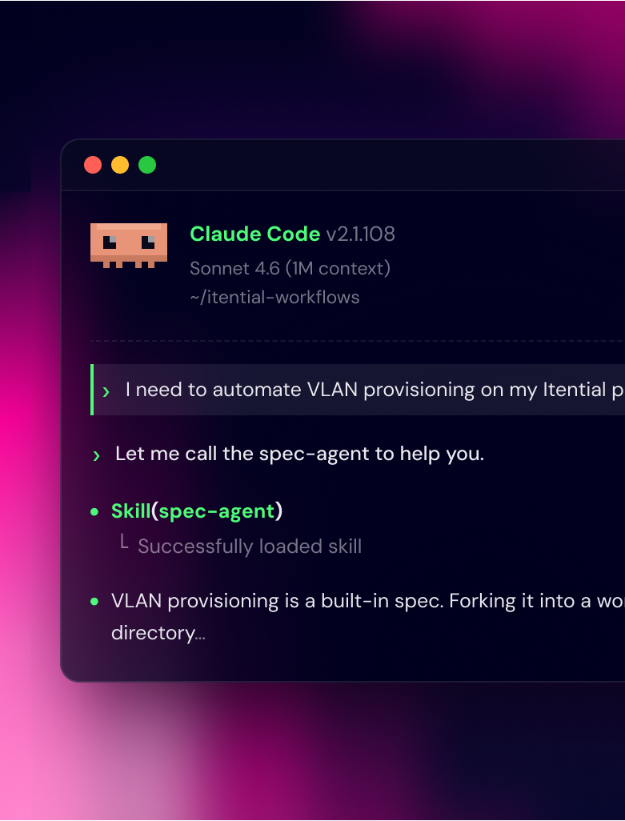
Learn More About Spec-Driven Development

Slide 33


Tacos, Agents & Great Connections
Tuesday, June 2
6:30 – 8:30 PM
Border Grill · Mandalay Bay
Space is Limited. RSVP Now.

Slide 34
All the presentations from the VibeOps Lounge are available on GitHub.
github.com/automateyournetwork/CiscoLive2026_VibeOpsLounge

